Slide 1

TE401

Slide 2
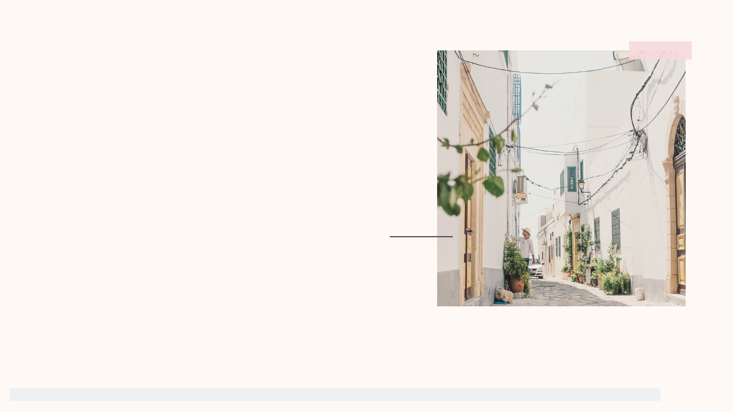
Recap
Surveyed 74 People
Interviewed 11 people (6 female, 5 male)
Narrowed down audience to college students (in our case, U of I)
Narrowed down topic to accessibility
Identified the areas of focus which require maximum attention to help women regarding reproductive health

Slide 3

Our goals are to educate those with periods about how to take care of their reproductive health, and help increase accessibility of sanitary products. We also want to find ways to improve the awareness regarding sanitary products, and research what solutions are already available and figure out how to optimize them.
Our
Goals

Slide 4

Behavioral
Frameworks
2 x 2

Slide 5
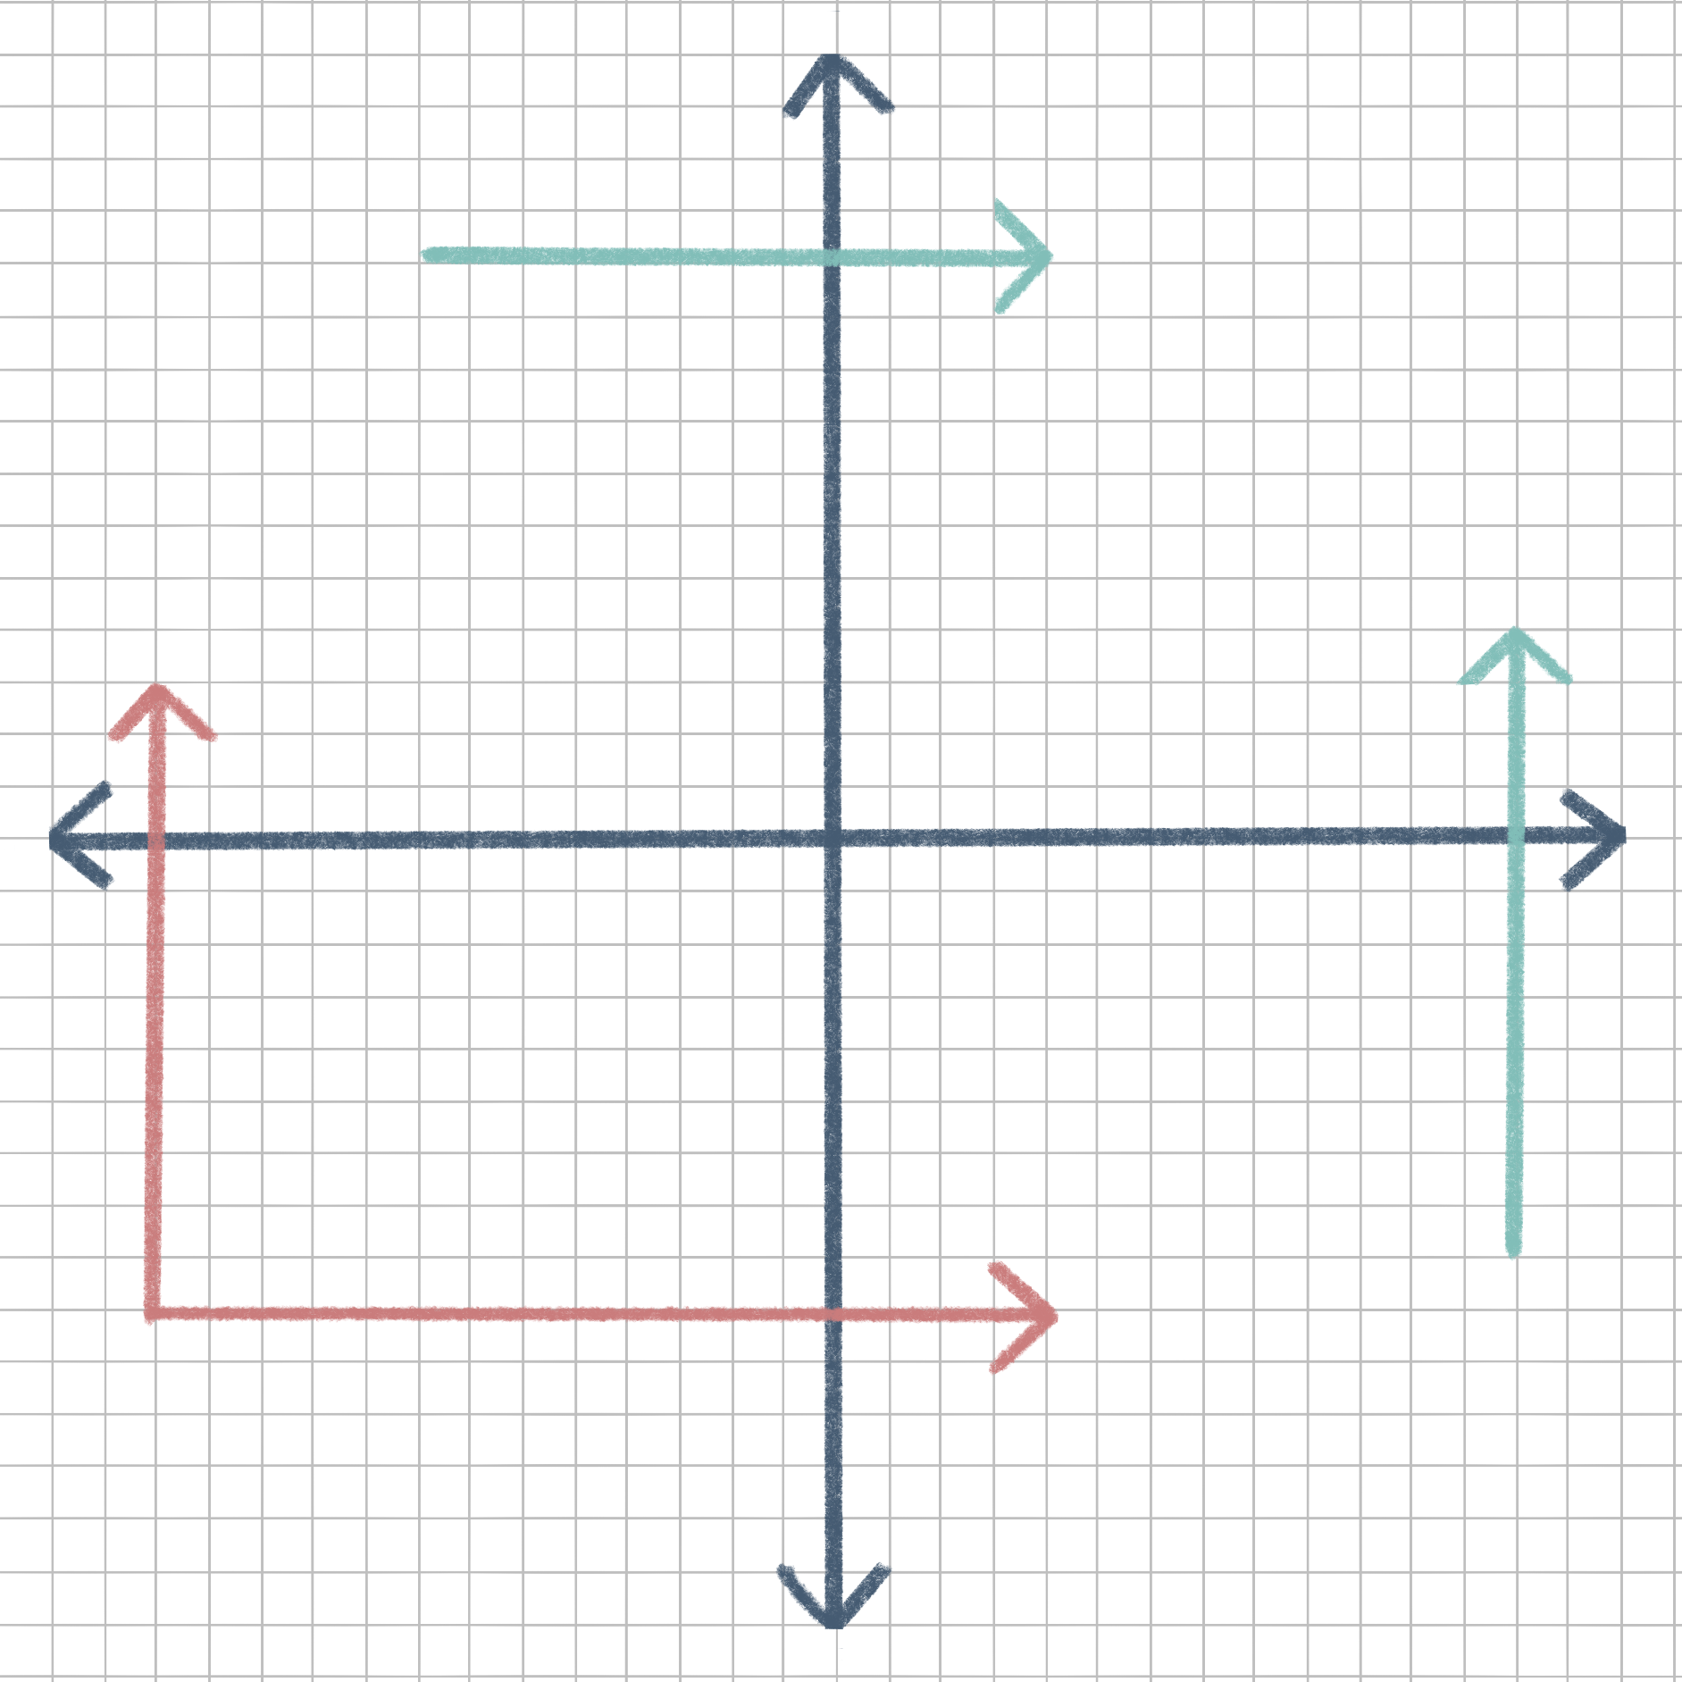
High Brand Trust
Brand Trust
Vs.
Quality
- Research Encouragement
- Eco-friendly solutions
Low Quality
High Quality
- Provide Quality
- Increase # of pads in a packet
Key:
Female Interviewees
Male Interviewees
Low Brand Trust

Slide 6
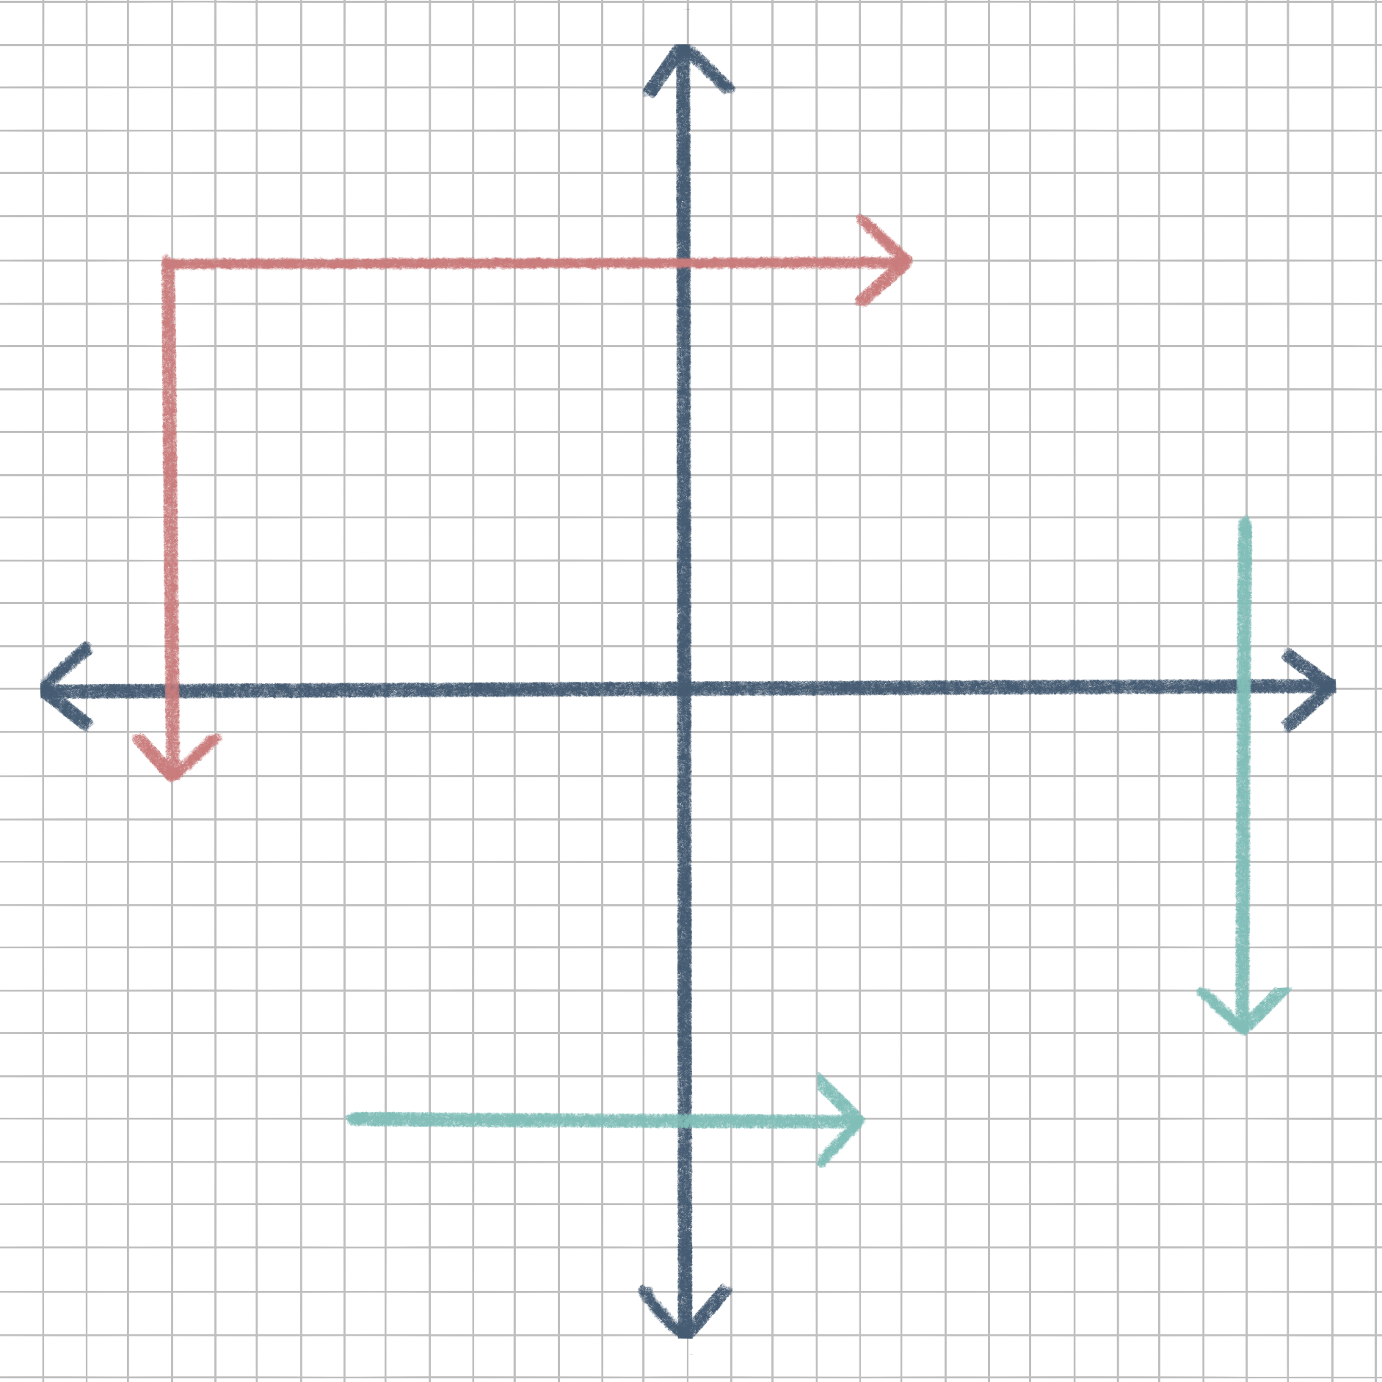
High Misuse
Misuse
Vs.
Cost
Misuse
Vs.
Cost
Low Cost
High Cost
- Put cap on
- Monitoring
- Ban Tampon Tax
- Tampon stamps
Key:
Female Interviewees
Male Interviewees
Low Misuse

Slide 7
High Access
Access
Vs.
Awareness
- Early Education
- Workshop Drives
Low Awareness
High Awareness
- NGO
- University-free Access
Key:
Female Interviewees
Male Interviewees
Low Access

Slide 8
Opportunity
Areas

Slide 9
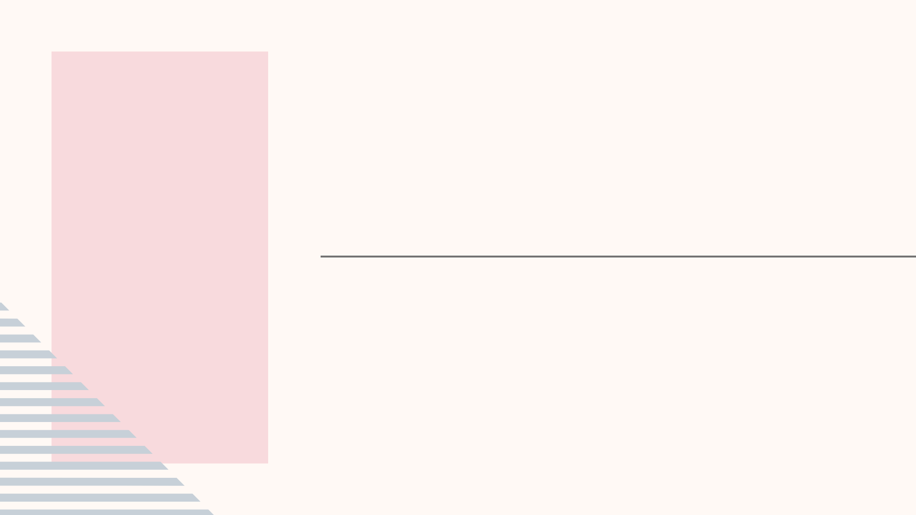
Opportunity Areas
1
Research on Environmentally Friendly Sanitary Products
Encouraging researchers and students through funding and workshops
Increase awareness and accessibility about the available products and their pros/cons.
Move forward in society as well as local community
2
Examples of completed research studies:
“A Study into Public Awareness of the Environmental Impact of Menstrual Products and Product Choice,” Elizabeth Peberdy et. al.
“Menstrual Equity in Public Higher Education,” Sara Darwish, NCSU.
Notes:
Filler slide - Opportunity areas

Slide 10
Concept
Ideation

Slide 11

Software Development
Planning
Literature Survey
Infer possible solutions from interviews and surveys
Designing
Product Requirements
Cost estimation
In-depth product blueprint
Development + Deployment
Components Identification
Development using Waterfall model
Unit Testing

Slide 12
Our next steps?

Slide 13
Introducing...
Notes:
I’ll make this slide prettier later

Slide 14
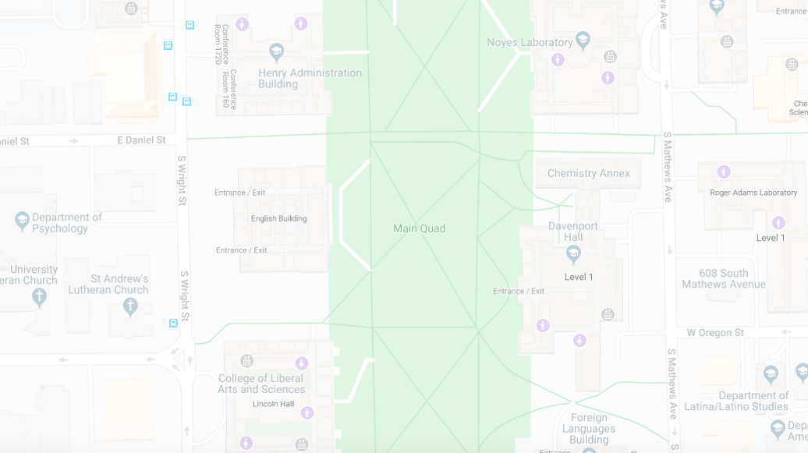

pin Pad

Slide 15
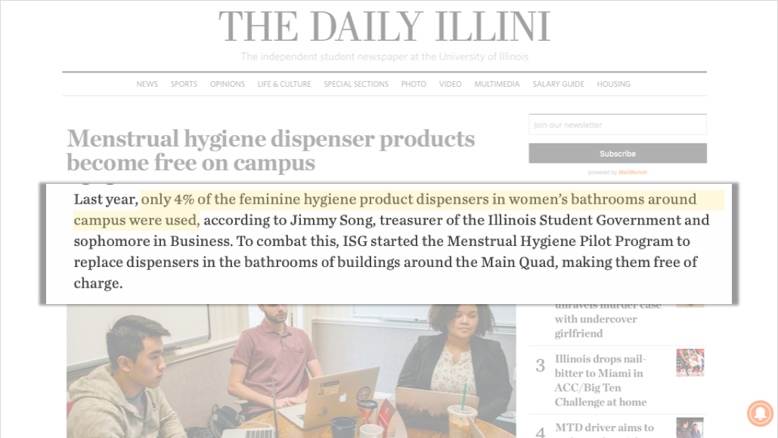

Slide 16
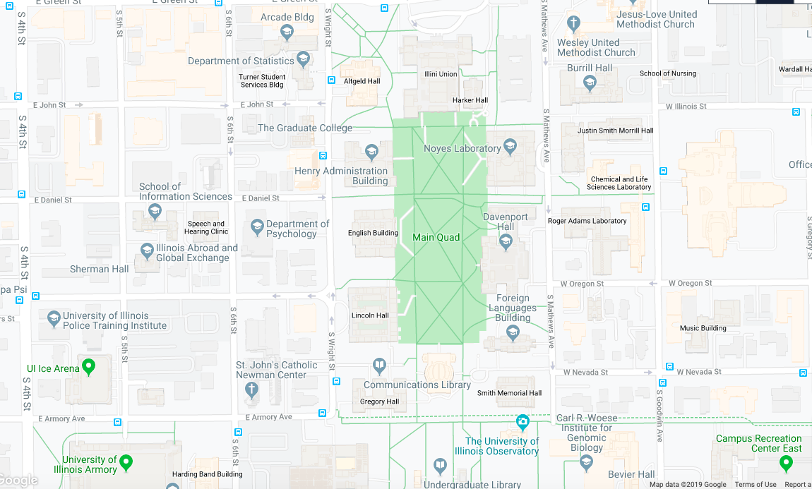
Map courtesy of Google Maps

Slide 17
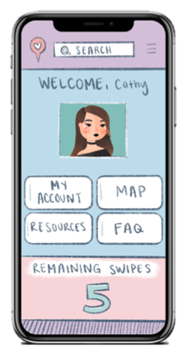
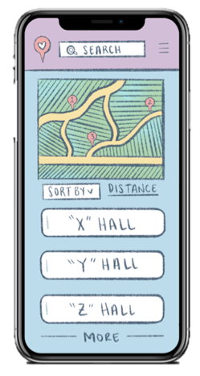
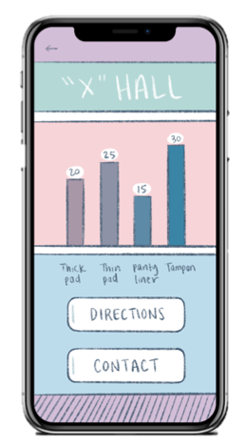
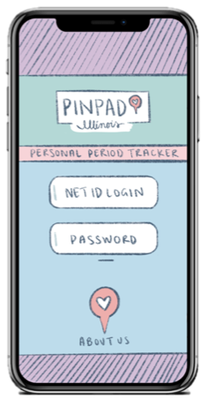

Slide 18
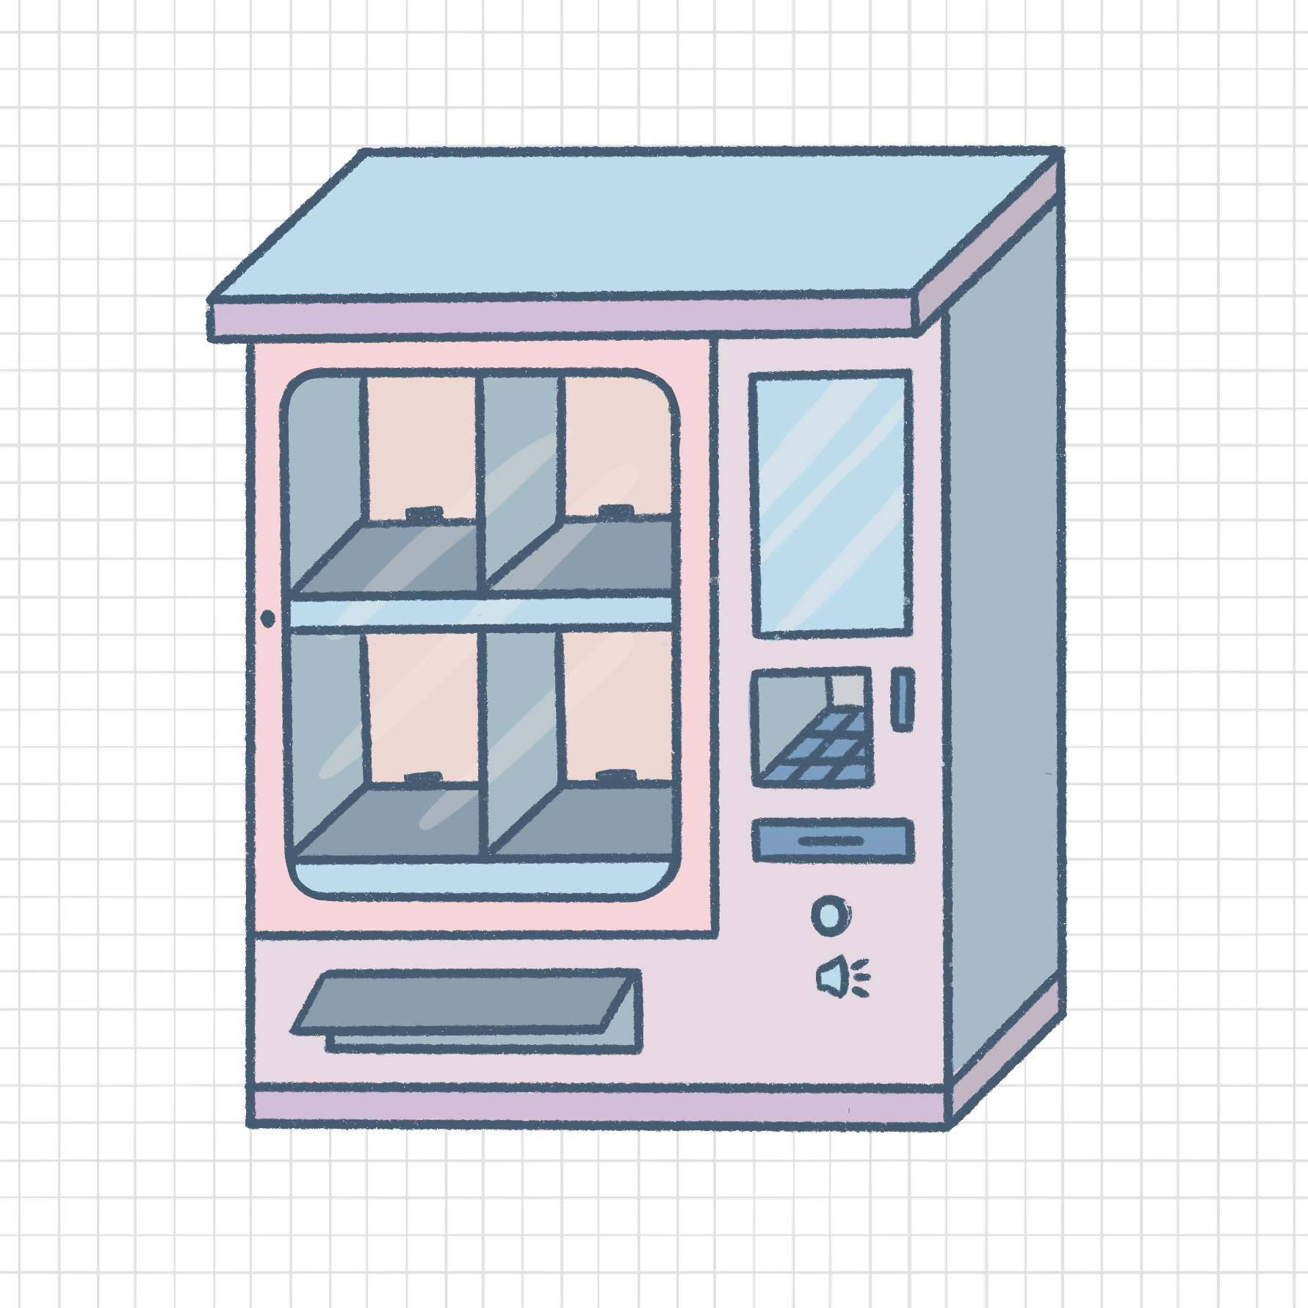
Our
Concept

Slide 19
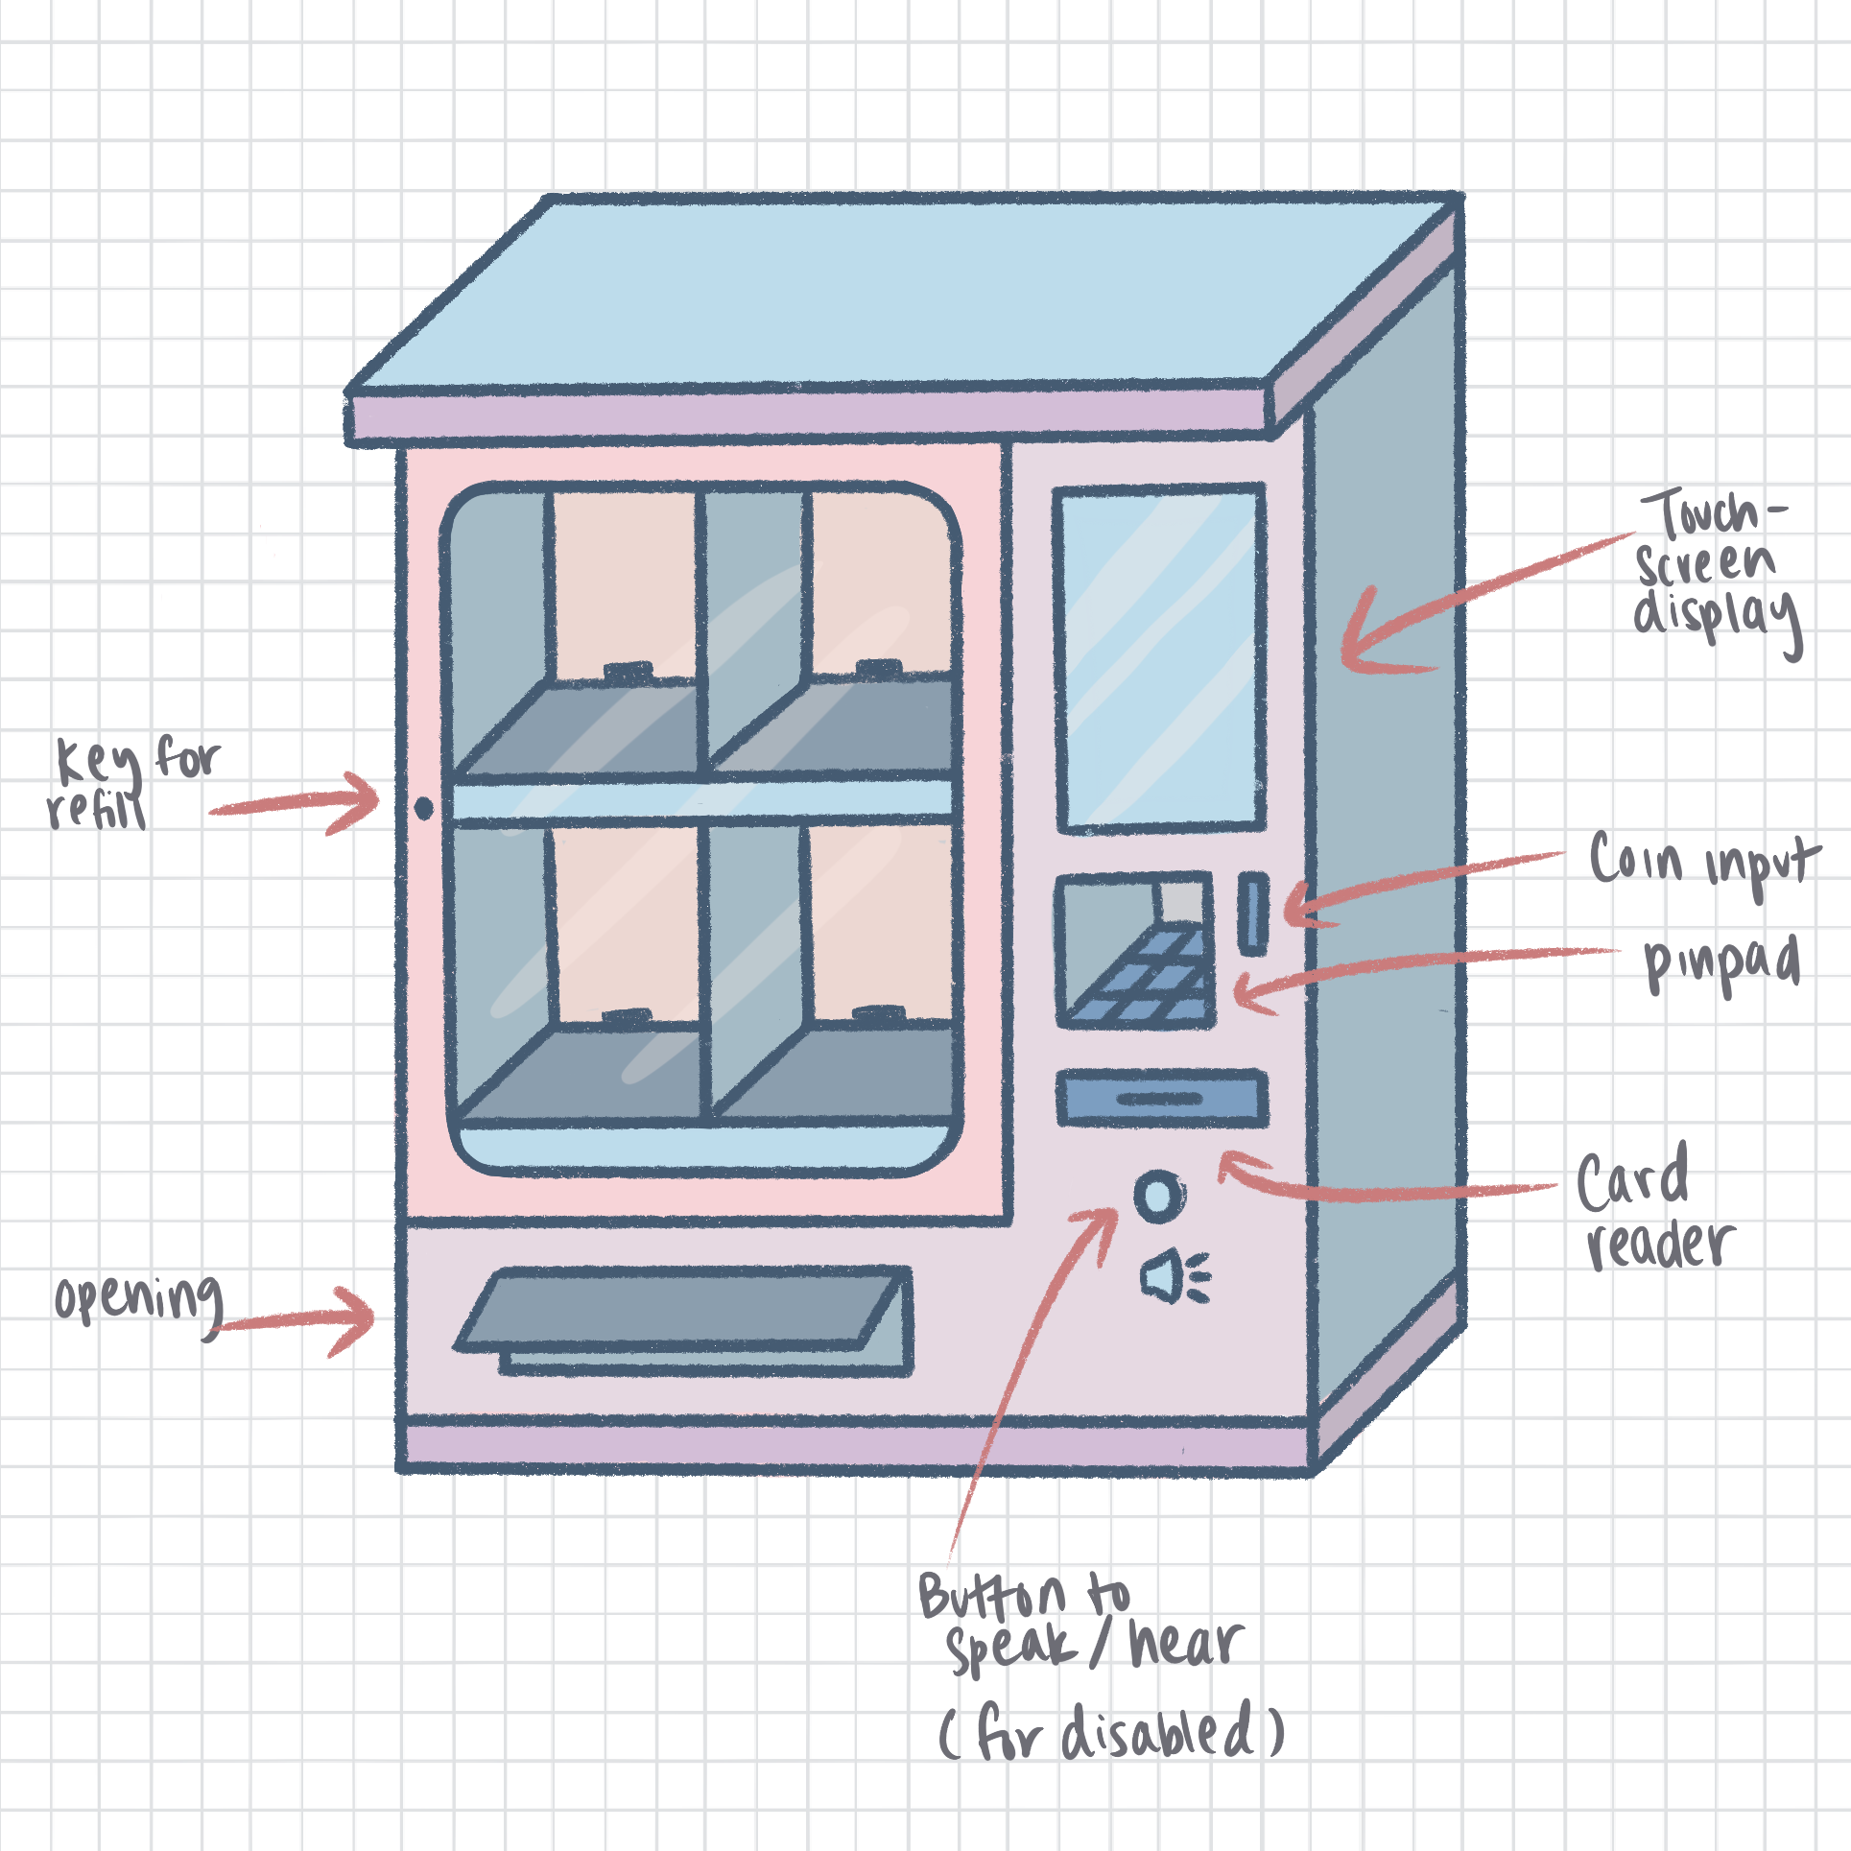

Slide 21
End Goal

Slide 22

Questions?

